Slide 1
AQUACULTURE AID
WATER QUALITY MONITORING AND NOTIFICATION SYSTEM
FOR FISH FARMING

Slide 2
Introduction
Water quality is the most important factor affecting fish health and performance in aquaculture production systems.
Fish farming is a form of aquaculture
This means that we must understand the water quality requirements of the fish under culture very well.
Fish live and are totally dependent on the water they live in for all their needs
Good water quality refers to what the fish wants and not what we think the fish wants.

Slide 3
Aspects of Water Quality
Different fish species have different and specific range of water quality aspects within which they can survive, grow and reproduce.
Physical
Temperature (fishes assume the temperature of the water they live in)
Turbidity
Chemical
pH
Salinity
Dissolved gases, etc.

Slide 4
Why consider water quality
The composition of pond water changes continuously, depending on climatic and seasonal changes, and on how a pond is used.
For producers to be able to maintain ideal pond water quality conditions, they must know and understand the physical and chemical aspects contributing to good or bad water quality.
Its effect on the fish so as to achieve maximum production.

Slide 5
Aim of the project
The goal of the project focuses on applying the knowledge of the various aspects (physical and chemical) that will contribute to attaining the good or ideal water quality suitable for your pond or fish by providing a means to monitor it periodically.
Fishes require a specific type of environment and range of water quality in order to survive, grow and reproduce.
Depending on the type of fish the producer or farmer wants to rear and knowledge of its specific requirements, our system would aid in easy monitoring and notifying the farmer of any anomalies.
This improves farmer’s response time to unsuitable change in pond’s condition.

Slide 6
Project components
An mega Arduino Board.
(16 * 2) LCD display.
The 2 in one Temperature and PH sensor- E-201-C.
The Turbidity Sensor- SEN0189.
A GSM shield- SIM900.
An ultrasonic Sensor.
4 RGB led (optional).
A buzzer (optional).

Slide 7
The system or device description
The device features:
2-in-1 temperature and pH sensor which measures the pH and temperature of the sample water.
The turbidity sensor which measures the clearness of the water.
An ultrasonic sensor to tell water levels.
The GSM shield to send values of reading through sms.
An lcd display to view values directly.
A web interface to collect data periodically and for purpose of analysis.

Slide 8
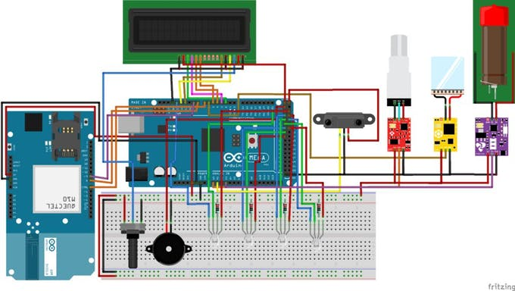
Diagram

Slide 9
THANK YOU

